Slide 1

Enrollment Management
2023-24
Session 4: Social Media Marketing

Slide 2
Welcome Principals, Directors and Enrollment Management Team Members

Slide 3
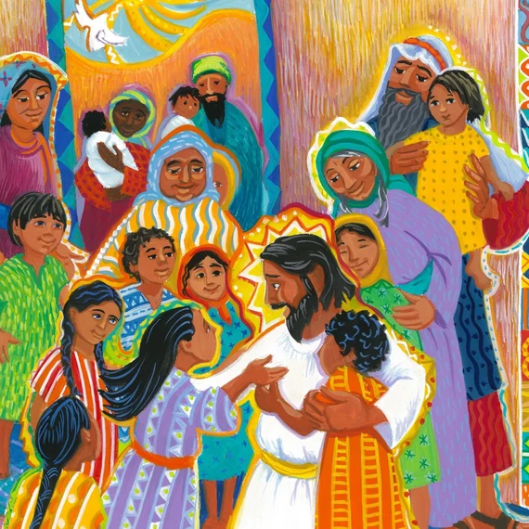
Prayer
Good and gracious God,
We pray that the focus and foundation of our Catholic schools will always be the person of Jesus Christ. May we remember that we are called to work together as part of your universal Church to build your kingdom in our midst.
Let each of our Catholic schools, no matter how large or how small, whether urban, suburban, or rural, be recognized by its commitment to excellence, its efforts to form the whole child, its hospitality towards all, and its intentional development as a community of faith, collaboration, trust, and love.
Help us to view every aspect of our world through the lens of the Gospel and the teachings of our faith, and let every member of our Catholic school communities become a visible example of what it means to put faith into action.
Amen.
Notes:
Prayer before Meetings
Heavenly Father, as we enter into this meeting, we bring your presence with us. We speak your peace, your grace, your mercy, and your perfect order. We acknowledge your power over all that will be spoken, thought, discussed, decided, and done during our meeting.
Lord, we thank you for the gifts you have given to us and we commit to using them responsibly in your honor. Give us a fresh supply of strength and compassion to do our job. Anoint our plans, ideas, and energies so that even our smallest accomplishment may bring you glory.
Lord, when we are confused, guide us, when we are anxious, comfort us, and when we are tired, infuse with the fire of the Holy Spirit.
May the work that we do and the way we do it bring faith, joy, and hope to all of those we serve today and every day.
We ask this through your son, Jesus Christ.
Amen.

Slide 4
Enrollment Management Team Training
Session 4
2023-24

Slide 5

Our Learning Goal…
Enrollment Management Teams
Enrollment Management Team
Members will be able to…
Celebrate current strengths and powerful practices in enrollment
Identify opportunities for growth
Implement immediate steps to recruit and retain students and families

Slide 6
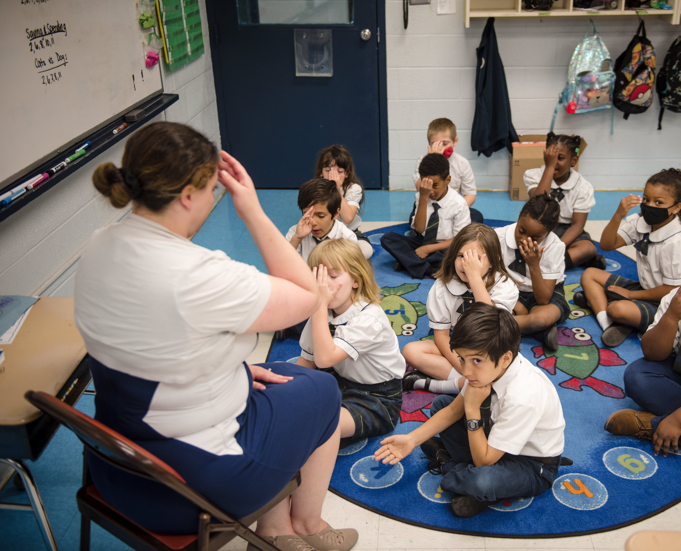
OPERATIONAL VITALITY
Enrollment Management Teams
One day we will:
Be accessible to and inclusive of any student regardless of socio-economic status, race, cultural background, religious affiliation or learning exceptionality.
We will retain and attract students so that every seat in every classroom in every school will be filled.

Slide 7

Social Media Marketing
Marketing 101 for Catholic Schools
Marketing to your Target Audience
Digital Marketing Strategies

Slide 8
Marketing 101 for Catholic Schools

Slide 9
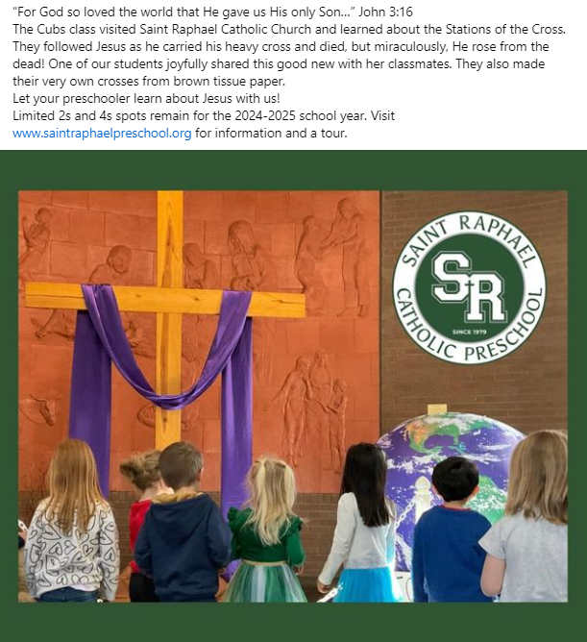
Every school action is a marketing action!
Branding = Identity ​
General Marketing = Attention ​
Target Marketing = Attraction ​
Micro Marketing = Relationship ​
Recruitment = Action ​
Application = Interest ​
Acceptance = Invitation ​
Enrollment = Decision ​
Retention = Fulfillment ​
GRADUATION = CELEBRATION

Slide 10
Definition of Marketing
"Marketing is the research, analysis, planning, implementation, and control of carefully formulated programs designed to bring about voluntary exchange of values with target markets to achieve institutional objectives." ​
"Strategic Marketing for Educational Institutions" by Philip Kotler and Karen Fox.

Slide 11

Research Findings – Parental Purchase Decision
Parental Purchase Decision: ​ Perception of Quality, Catholic Education ​​
Religious Values Infused In The Curriculum ​
Safety, Structure, and Discipline

Slide 12
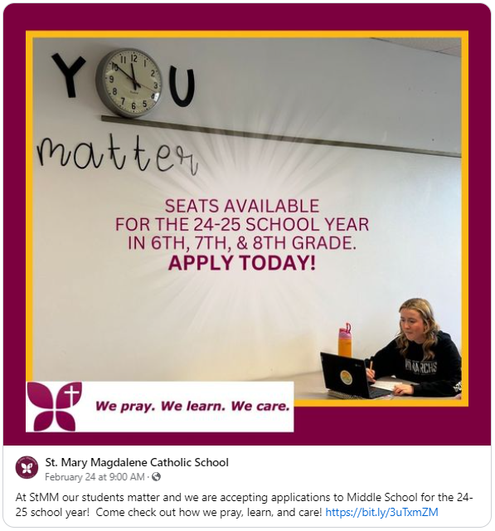
Research Findings – PreK-8 Purchase Decision
Elementary School Purchase Decision: ​​ Decision Maker: Mother, child is 3 to 3 ½ years old ​
Influencers: Friends, neighbors, other moms, family, entry level teachers, day care providers

Slide 13
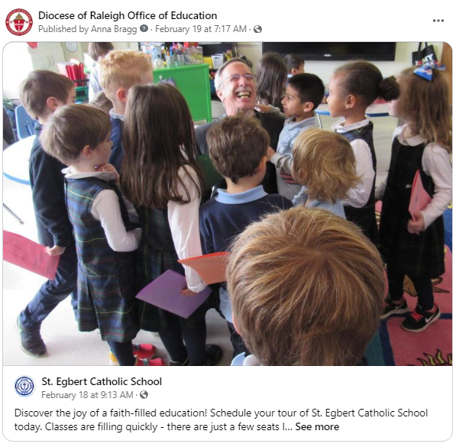
Principle 1: Catholic Schools Can Be Marketed for Three Things Only
Image (In real estate, you would hear “Location, location, location”… for our schools, it’s “image, image, image”!)
Targeted Enrollment
Resources for Students and Families

Slide 14

Principle 2: The Value Proposition ​
People buy based on value, not just price

Slide 15
Principle 3: People buy based on value, not just price
People make a school decision on value, not just price
Here are some ways a Catholic school can demonstrate its value to parents:
1. Highlight the school's faith-based education and moral foundation. Explain how the Catholic values and teachings are integrated into the curriculum and daily life of the school.
2. Emphasize the school's academic excellence. Share data on standardized test scores, college acceptance rates, and any special academic programs or resources available to students.
3. Showcase the school's well-rounded approach to education. Discuss extracurricular activities, clubs, sports teams, community service opportunities, and ways the school nurtures students' intellectual, physical, and spiritual growth.

Slide 16
Principle 3: People buy based on value, not just price
4. Discuss the school's commitment to character development and instilling positive values such as respect, integrity, service, and leadership in students.
5. Highlight the sense of community within the school. Share how the school fosters a welcoming, supportive environment for families and builds a strong parent-teacher partnership.
6. Provide examples of how the school prepares students for life after graduation, whether through college counseling, career guidance, or teaching essential life skills.
7. Invite current parents to share testimonials about their positive experiences and the impact the school has had on their children.
8. Offer opportunities for prospective parents to visit the school, observe classes, and interact with teachers and students to get a firsthand look at the school's culture and atmosphere.
The key is to clearly articulate the school's unique value proposition, rooted in its Catholic identity, academic rigor, and commitment to the holistic development of students.

Slide 17
Principle 4: Logic vs. Emotion in Marketing
Emotional brain influences decisions more than rational brain
“The rational brain is great at rationalizing what the emotional brain has already decided.” (Baba Shiv, Marketing Professor, Stanford Business School)
Prospective families must understand your school not just on an intellectual level, but on an emotional one.
They have to feel/experience what you are about.
Can they “see” themselves as part of your community?

Slide 18
Marketing to your Target Audience

Slide 19
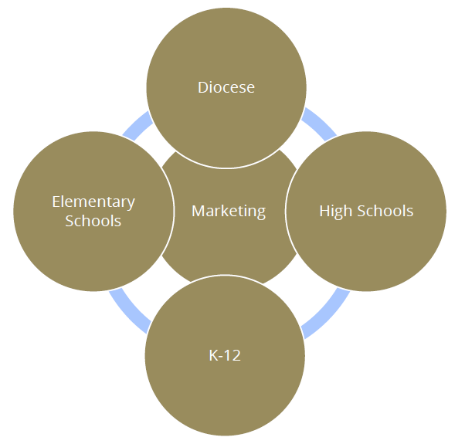
Areas of Expertise
Advancement
Enrollment Management
Strategic Communications
Administration

Slide 20

How to Use Digital Marketing to Reach Your Target Audience
Introduction to the purpose of marketing and how technology has changed our approach.
​Explanation of digital marketing and its relevance to Catholic schools. ​
Overview of the benefits of digital marketing.

Slide 21
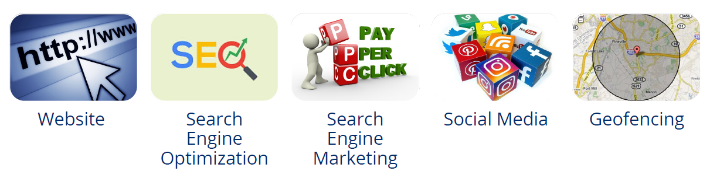
Examples of Digital Marketing
Website
Search engine optimization (SEO)
Search engine marketing (SEM)
Social media
Geofencing

Slide 22
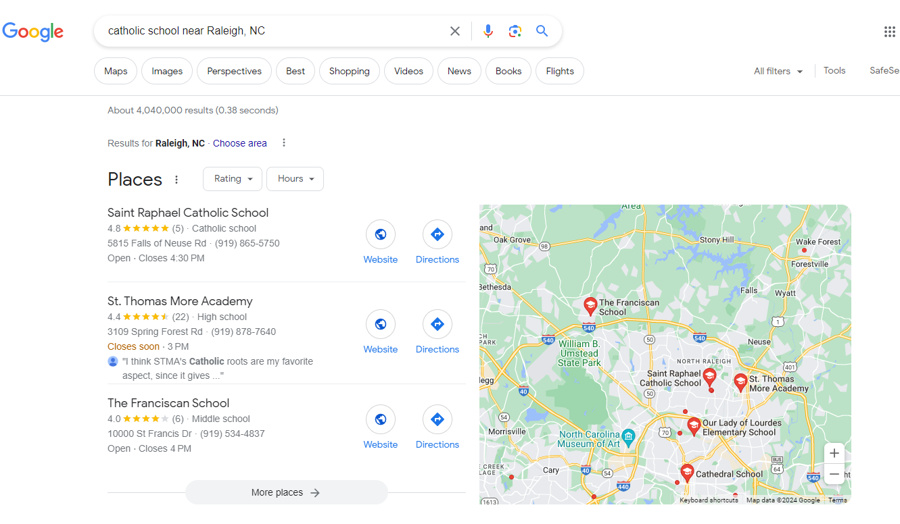
Search Engine Optimization (SEO)
SEO is defined as “the process of getting traffic from free, organic, editorial or natural search results.”
How easily can Google find you?
Increase traffic to your site

Slide 23
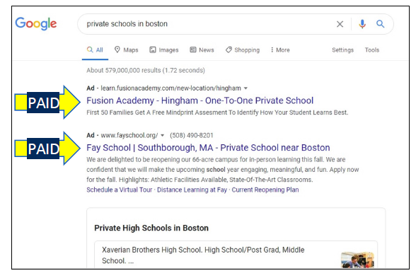
Search Engine Optimization (Marketing)
SEM is defined as, “the process of gaining website traffic by purchasing ads on search engines.”
Paid ads on search engines like Google.
Pay-per-click.
Google Ads- ads.google.com

Slide 24
Geofencing
Geofencing allows Catholic schools to deliver targeted advertising and promotional content to potential students and their families based on their location.
By setting up virtual perimeters around relevant areas, such as neighborhoods with a high concentration of prospective families, schools can send push notifications, text messages, or in-app advertisements to devices within those designated zones.
This targeted approach ensures that marketing efforts reach the intended audience at the right time and place, increasing the chances of capturing their interest.
Try a Google search for “geofencing raleigh nc”!

Slide 25
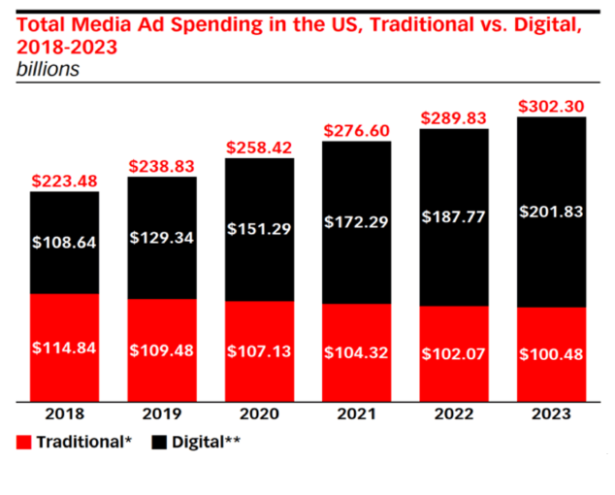
Benefits of Digital Marketing
Quick delivery
Low cost
Targeted audience
Reach
Interaction
Measurable

Slide 26

Enrollment Management – Core Competencies

Slide 27
Digital Marketing Strategies

Slide 28

Why is Digital Marketing Important?
Increased Visibility
Authenticity
Cost-Effectiveness
Brand Awareness
Targeted Marketing
Enhanced Communication
Timeliness

Slide 29
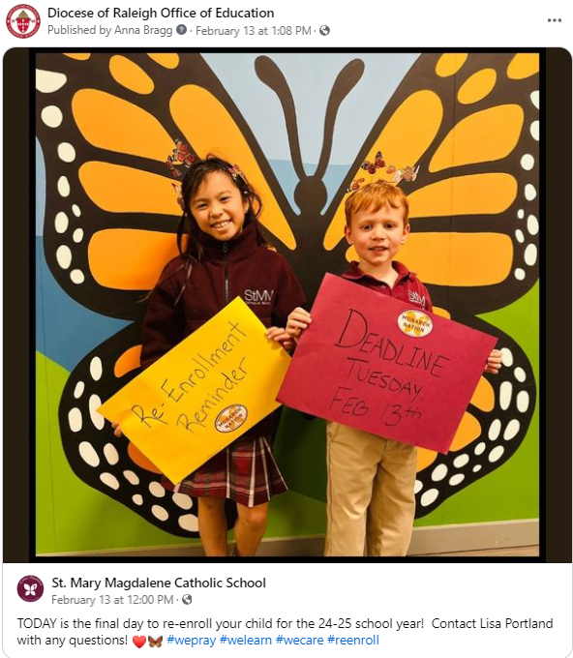
Digital Marketing for Promotion and Engagement
• Comprehensive, updated, user friendly
website
• Engaging social media
• Online advertising
• Email marketing
• Word of Mouth posting

Slide 30

Digital Marketing Challenges
Limited Budgets
Time Constraints
Human Resources
Reach
Authenticity
Timeliness
Enrollment Management Team Member

Slide 31
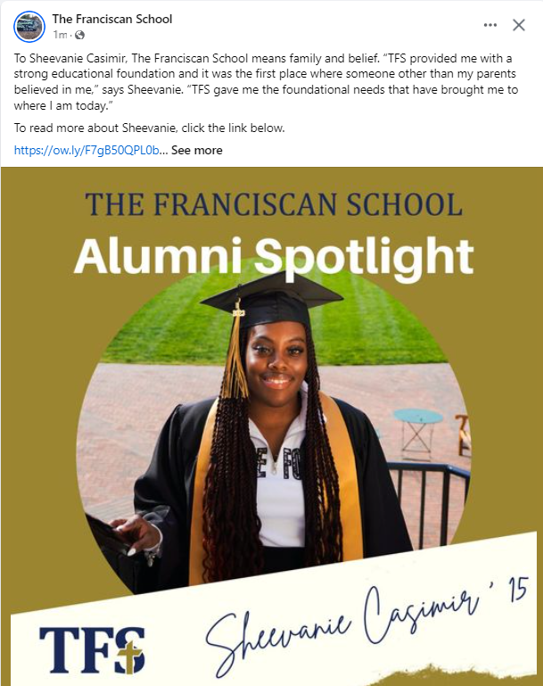

Key “E” Words
Effective
Efficient
Engaging
Encouraging

Slide 32
OPERATIONAL VITALITY
Enrollment Management Feedback and CEU Request
Please complete the 2024-25 EMT Planning Jotform located at https://form.jotform.com/schoolsoffice/2024-25EMTTrainingPlanning
If you would like to request CEUs, please complete the 2023-24 EMT CEU Request Jotform, located at https://form.jotform.com/schoolsoffice/2023-24EMTTraining

Slide 33
OPERATIONAL VITALITY
Enrollment Management Training - Questions
One day we will:
Be accessible to and inclusive of any student regardless of socio-economic status, race, cultural background, religious affiliation or learning exceptionality.
We will retain and attract students so that every seat in every classroom in every school will be filled.

Slide 34
Prayer
Loving God,
You are present to us whenever we gather as a faith community.
We pray that our schools will be places where everyone feels accepted, safe, and beloved.
Help our schools and our local communities be places of faith so that we can help others believe in You.
Fill us with Your Spirit so that we may reflect Your light and love to each other and the whole world as one Body of Christ.
We ask this of Jesus, Your Son, who lives and reigns with You, in the unity of the Holy Spirit, one God, forever and ever.
Amen.
Notes:
Prayer before Meetings
Heavenly Father, as we enter into this meeting, we bring your presence with us. We speak your peace, your grace, your mercy, and your perfect order. We acknowledge your power over all that will be spoken, thought, discussed, decided, and done during our meeting.
Lord, we thank you for the gifts you have given to us and we commit to using them responsibly in your honor. Give us a fresh supply of strength and compassion to do our job. Anoint our plans, ideas, and energies so that even our smallest accomplishment may bring you glory.
Lord, when we are confused, guide us, when we are anxious, comfort us, and when we are tired, infuse with the fire of the Holy Spirit.
May the work that we do and the way we do it bring faith, joy, and hope to all of those we serve today and every day.
We ask this through your son, Jesus Christ.
Amen.

